Slide 1
Week 04 – JavaScript Recap
Introduction to the JavaScript
Variables in JS
Operators in JS
Control structures in JS
DOM

Slide 2

IT1100 Internet and Web technologies Lecture 05 Developing Multimedia for the Web

Slide 3
Content
HTML5 media support
Responsive web design with CSS
Using CSS+JS plugins/libraries

Slide 4
1. HTML5 media support
The first web browsers
text only
limited to a single font
single color
Later came browsers
support for colors
Fonts
images!
Audio, video, and animation have been handled differently by the major browsers.
Different formats have been supported, and some formats require extra helper programs (plug-ins) to work.

Slide 5
1. HTML5 media support
HTML5 promises an easier future for multimedia (almost anything you can hear or see)
Multimedia Formats
Multimedia elements (like audio or video) are stored in media files.
Multimedia files have formats and different extensions like:
.swf, .wav, .mp3, .mp4, .mpg, .wmv, and .avi.
Only MP4, WebM, and Ogg video are supported by the HTML5 standard.
Only MP3, WAV, and Ogg audio are supported by the HTML5 standard.
https://www.w3schools.com/htmL/html_media.asp

Slide 6
1. HTML5 media support HTML video
File Format | Media Type
MP4 | video/mp4
WebM | video/webm
Ogg | video/ogg
<video width="320" height="240" controls> <source src="movie.mp4" type="video/mp4"> <source src="movie.ogg" type="video/ogg"> Your browser does not support the video tag. </video>

Slide 7
1. HTML5 media support HTML audio
File Format | Media Type
MP3 | audio/mpeg
Ogg | audio/ogg
Wav | audio/wav
<audio controls> <source src="horse.ogg" type="audio/ogg"> <source src="horse.mp3" type="audio/mpeg"> Your browser does not support the audio element. </audio>

Slide 8
<!DOCTYPE html>
<html>
<head>
<title>Page Title</title>
</head>
<body>
<video controls
muted
src="Famous_Failures.mp4"
width="300"
height="200">
Sorry, your browser doesn't support embedded videos.
</video>
</body>
</html>
Demo HTMLVideo.html

Slide 9
Question
What are the common Audio and Video Formats in web applications?
Visit - https://www.w3schools.com/htmL/html_media.asp

Slide 10
1. HTML5 media support CSS3
CSS3 also provides support for developing some visual effects such as
Transitions
Smooth change of the properties over a given duration
Transformations
Transformations provide an effect of content/object
Animations
Animations allow to animate content

Slide 11
1. HTML5 media support CSS3 - Transitions
Transitions allow to have a smooth change of the properties over a given duration
transition
transition-delay
transition-duration
transition-property
transition-timing-function
https://www.w3schools.com/css/css3_transitions.asp

Slide 12
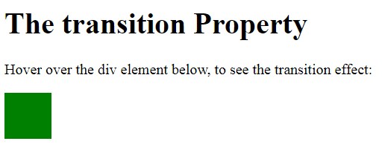
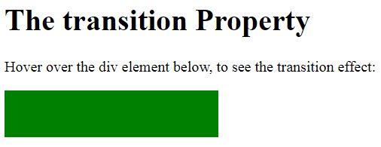
1. HTML5 media support CSS3 - Transitions
<!DOCTYPE html>
<html>
<head>
<style>
div {
width: 50px;
height: 50px;
background: green;
transition: 5s;
}
div:hover {
width: 500px;
}
</style>
</head>
<body>
<h1>The transition Property</h1>
<p>Hover over the div element below, to see the transition effect:</p>
<div></div>
</body>
</html>
Demo:Transition.html
Output

Slide 13
1. HTML5 media support CSS3 - Transformations
Transformations provide an effect of content/object change 3 types of properties
Translate (change position)
Rotate (change angle)
Scale(change size)
CSS3 has two versions of transformations
2D transformations
3D transformations
https://www.w3schools.com/css/css3_2dtransforms.asp
https://www.w3schools.com/css/css3_3dtransforms.asp

Slide 14
1. HTML5 media support CSS3 - 2D transformation methods:
translate() | moves an element from its current position (according to the parameters given for the X-axis and the Y-axis).
rotate() | rotates an element clockwise or counter-clockwise according to a given degree
scale() | increases or decreases the size of an element (according to the parameters given for the width and height)
skewY() | method skews an element along the X-axis by the given angle.
skewY() | method skews an element along the Y-axis by the given angle
matrix() | combines all the 2D transform methods into one. The matrix() method take six parameters, containing mathematic functions, which allows you to rotate, scale, move (translate), and skew elements

Slide 15
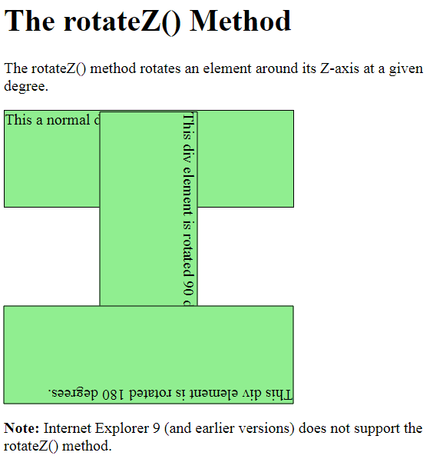
<!DOCTYPE html>
<html>
<head>
<style>
div {
width: 300px;
height: 100px;
background-color: yellow;
border: 1px solid black;
}
#myDiv {
transform: rotateZ(90deg);
}
#myDiv1 {
transform: rotateZ(180deg);
}
</style>
</head>
<body>
<h1>The rotateZ() Method</h1>
<p>The rotateZ() method rotates an element around its Z-axis at a given degree.</p>
<div>
This a normal div element.
</div>
<div id="myDiv">
This div element is rotated 90 degrees.
</div>
<div id="myDiv1">
This div element is rotated 180 degrees.
</div>
<p><b>Note:</b> Internet Explorer 9 (and earlier versions) does not support the rotateZ() method.</p>
</body>
</html>
Transformations.html
Output

Slide 16
1. HTML5 media support CSS3 - Animations
CSS3 animations allow to animate content
It uses keyframe animation
You can define a set of keyframes by specifying a name using the @keyframes
Then that keyframe set can be used by setting the animation-name rule
https://www.w3schools.com/css/css3_animations.asp

Slide 17
1. HTML5 media support CSS3 - Animations
<!DOCTYPE html>
<html>
<head>
<style>
div {
width: 100px;
height: 100px;
background-color: red;
position: relative;
animation-name: example;
animation-duration: 4s;
}
@keyframes example {
0% {background-color:red; left:0px; top:0px;}
25% {background-color:yellow; left:200px; top:0px;}
50% {background-color:blue; left:200px; top:200px;}
75% {background-color:green; left:0px; top:200px;}
100% {background-color:red; left:0px; top:0px;}
}
</style>
</head>
<body>
<p><b>Note:</b> This example does not work in Internet Explorer 9 and earlier versions.</p>
<div></div>
</body>
</html>
Demo: Animation.html

Slide 18
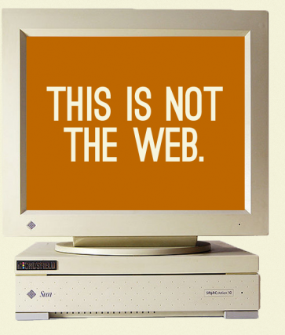
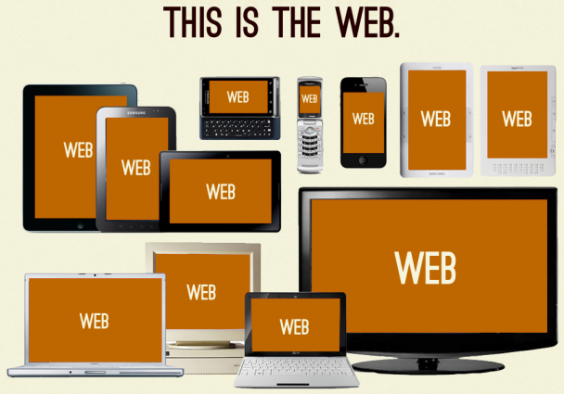
2. Responsive web design
The web is not fixed width
Flexibility is the new norm

Slide 19
2. Responsive web design What is Responsive Web Design?
A web page should look good on any device!
Responsive Web Design is
about using HTML and CSS
to automatically resize, hide, shrink, or enlarge,
a website,
to make it look good
on all devices (desktops, tablets, and phones)

Slide 20
2. Responsive web design Setting The Viewport
When making responsive web pages, add the following <meta> element in all your web pages:
<meta name="viewport" content="width=device-width, initial-scale=1.0">
This will set the viewport of your page, which will give the browser instructions on how to control the page's dimensions and scaling.

Slide 21

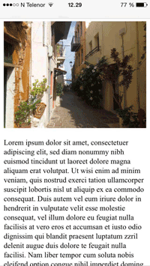
2. Responsive web design Setting The Viewport
Here is an example of a web page without the viewport meta tag, and the same web page with the viewport meta tag:

Slide 22
Visit www.w3schools.com and read
Responsive Images –
Responsive images are images that scale nicely to fit any browser size.
Responsive Text Size –
The text size can be set with a "vw" unit, which means the "viewport width“
Viewport is the browser window size.
1vw = 1% of viewport width. If the viewport is 50cm wide, 1vw is 0.5cm.

Slide 23
2. Responsive web design CSS3 Introduced Media Queries
Media queries in CSS3 extended the CSS2 media types idea: Instead of looking for a type of device, they look at the capability of the device.
Media queries can be used to check many things, such as:
width and height of the viewport
width and height of the device
orientation (is the tablet/phone in landscape or portrait mode?)
resolution
Media queries are a popular technique for delivering a tailored style sheet to desktops, laptops, tablets, and mobile phones (such as iPhone and Android phones).
Notes:
Text reflows but not images.

Slide 24
2. Responsive web design Media Query Syntax
A media query consists of a media type and can contain one or more expressions, which resolve to either true or false.
@media not | only mediatype and (expressions) { CSS-Code; }
The result of the query is true if the specified media type matches the type of device the document is being displayed on and all expressions in the media query are true.
When a media query is true, the corresponding style sheet or style rules are applied, following the normal cascading rules.
Notes:
Text reflows but not images.

Slide 25
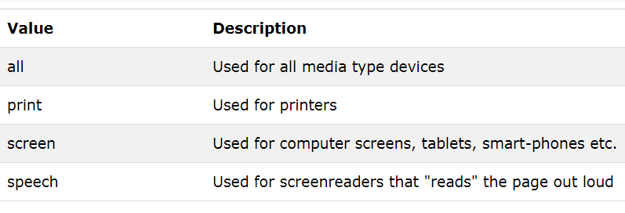
2. Responsive web design Media Query– Demo1
<!DOCTYPE html>
<html>
<head>
<style>
body {
background-color: pink;
}
@media screen and (min-width: 480px) {
body {
background-color: lightgreen;
}
}
</style>
</head>
<body>
<h1>Resize the browser window to see the effect!</h1>
<p>The media query will only apply if the media type is screen and the viewport is 480px wide or wider.</p>
</body>
</html>
https://www.w3schools.com/css/tryit.asp?filename=trycss3_media_queries1
Notes:
Text reflows but not images.

Slide 26
2. Responsive web design Media Query– Demo3
<!DOCTYPE html>
<html>
<head>
<meta name="viewport" content="width=device-width, initial-scale=1.0">
<style>
.wrapper {overflow: auto;}
#main {margin-left: 4px;}
#leftsidebar {
float: none;
width: auto;
}
#menulist {
margin: 0;
padding: 0;
}
.menuitem {
background: #CDF0F6;
border: 1px solid #d4d4d4;
border-radius: 4px;
list-style-type: none;
margin: 4px;
padding: 2px;
}
@media screen and (min-width: 480px) {
#leftsidebar {width: 200px; float: left;}
#main {margin-left: 216px;}
}
</style>
</head>
<body>
<div class="wrapper">
<div id="leftsidebar">
<ul id="menulist">
<li class="menuitem">Menu-item 1</li>
<li class="menuitem">Menu-item 2</li>
<li class="menuitem">Menu-item 3</li>
<li class="menuitem">Menu-item 4</li>
<li class="menuitem">Menu-item 5</li>
</ul>
</div>
<div id="main">
<h1>Resize the browser window to see the effect!</h1>
<p>This example shows a menu that will float to the left of the page if the viewport is 480 pixels wide or wider. If the viewport is less than 480 pixels, the menu will be on top of the content.</p>
</div>
</div>
</body>
</html>
https://www.w3schools.com/css/tryit.asp?filename=trycss3_media_queries2
Notes:
Text reflows but not images.

Slide 27
2. Responsive web design Media Queries
Media features
width, height, device-width, device-height,orientation
aspect-ratio, device-aspect-ratio, resolution, scan, grid
color, color-index, monochrome
<link media=“(min-width: 30em)” …
<link media=“screen and (max-width: 30em)” …
@media (orientation: portrait) { … }
@media screen and (color) { … }
https://www.w3.org/TR/css3-mediaqueries/#media1
Notes:
Go read the spec
Width vs device-width
Width = viewport width
Device width is device width in its standard orientation

Slide 28
2. Responsive web design Media Queries
@media (min-width: 600px)
{
/* styles for 600px and up */
}
@media (max-width: 38em)
{
/* styles for 38em and down */
}
2 approaches
Large res first
Small res first
The ‘em’ value is relative to the initial value of ‘font-size’.

Slide 29
2. Responsive web design Media Queries – Large res first
/* large resolution layouts here */
h1{…}
…………..
@media (max-width: 62em) {
/* break point: styles for 62em and down go here */
}
@media (max-width: 40em) {
/* break point: styles for 40em and down go here */
}
Notes:
Two ways to approach writing your media queries: large resolution first or small resolution first.
Leave large existing site and then add rules to undo some complex layout at large resolution (substracting css)

Slide 30
2. Responsive web design Media Queries – Large res first
Example
<body>
<p class="left">
Some text…..
</p>
<p class="right">
Some text…..
</p>
</body>
Notes:
Two ways to approach writing your media queries: large resolution first or small resolution first.
Leave large existing site and then add rules to undo some complex layout at large resolution (substracting css)

Slide 31
2. Responsive web design Media Queries – Large res first
.left { width:50%; float:left; margin: 0px; background-color: brown; } .right { width:50%; float:left; margin: 0px; background-color: burlywood; } | @media(max-width:800px) { .left { width:100%; float: left; } .right { width:100%; float: none;; } }
Notes:
Two ways to approach writing your media queries: large resolution first or small resolution first.
Leave large existing site and then add rules to undo some complex layout at large resolution (substracting css)

Slide 32
2. Responsive web design Media Queries – Small res first
/* smallest resolution layouts here */
h1{…}
…………..
@media (min-width: 28em) {
/* break point: styles for 28em and up here */
}
@media (min-width: 53em){
/* break point: styles for 53em and up here */
}
The ‘em’ value is relative to the initial value of ‘font-size’.
Notes:
Small resolution first is the exact opposite. Additive css.

Slide 33
3. Using CSS+JS plugins/libraries
To develop more advance features, frameworks, libraries, or plugins can be used
Frameworks offer more features and can be either a complete or a micro framework.
Libraries provide asset of related features
Plugin can be seen as a pre-developed, working component

Slide 34
3. Using CSS+JS plugins/libraries
jQuery – A JS library, but can be seen a framework too. It wraps the complexity of pure JS. Many JS frameworks, libraries, and plugins are built using jQuery
Bootstrap – to design and develop responsive web pages rapidly

Slide 35
3. Using CSS+JS plugins/libraries
Angular – a JS framework/platform to build frontend applications
React – a JavaScript library for building user interfaces (and the application, which uses that UI)
Node.js - is an open source server environment. Node.js uses JavaScript on the server

Slide 36
3. Using CSS+JS plugins/libraries
There are many CSS+JS plugins to make the GUI of the webpages more attractive by developing various media components and effects
https://www.cssdesignawards.com/blog/best-js-plugins-and-libraries-of-2015/267/
https://speckyboy.com/top-50-javascript/

Slide 37
3. Using CSS+JS plugins/libraries Using them in your app
Basically, there are two main methods of using them
Download the package from the source, keep a copy in your site, and link the necessary files to your page
Link directly to the files in a Content Delivery Network (CDN), without downloading them

Slide 38
3. Using CSS+JS plugins/libraries Using them in your app
Download the package from the source
Simple text effects with textillate.js
Go to he official site and download the dependencies
https://textillate.js.org/
Copy the dependencies to your site and link them
<link rel="stylesheet" type="text/css" href="animate.css" />
<script src="http://ajax.googleapis.com/ajax/libs/jquery/1.9.0/jquery.min.js"></script>
<script src="jquery.lettering.js"></script>
<script src="jquery.textillate.js"></script>

Slide 39
3. Using CSS+JS plugins/libraries Using them in your app
3. Add HTML content you want to use with the textillate
<h1 class="tlt">Hello world</h1>
4. Add the JS to enable the textillate
<script>
$(function (){
$('.tlt').textillate();
});
</script>

Slide 40
Download the package from the source
<html>
<head>
<link rel="stylesheet" type="text/css" href="assets/animate.css" />
<script src="http://ajax.googleapis.com/ajax/libs/jquery/1.9.0/jquery.min.js"></script> <script src="assets/jquery.lettering.js"></script>
<script src="jquery.textillate.js"></script>
<script>
$(function (){
$('.tlt').textillate();
});
</script>
</head>
<body>
<h1 class="tlt">Hello world</h1>
</body>
</html>
demo.html
Notes:
File “demo.htm” is inside of the “textillate-master” folder

Slide 41
3. Using CSS+JS plugins/libraries Using them in your app
When using a CDN
the files are maintained by the original developers, they do bug fixing and updating
Since the file is downloaded from the CDN server, it saves the bandwidth of your server

Slide 42
Link directly to the files in a Content Delivery Network (CDN)
<html>
<head>
<script src="http://cdnjs.cloudflare.com/ajax/libs/jquery/2.1.0/jquery.js"></script>
<script src="http://cdnjs.cloudflare.com/ajax/libs/lettering.js/0.6.1/jquery.lettering.min.js"></script>
<script src="https://jschr.github.io/textillate/jquery.textillate.js"></script>
<script>
$(function (){
$('.tlt').textillate();
});
</script>
</head>
<body>
<h1 class="tlt">Hello world</h1>
</body>
</html>
demo1.html
Notes:
File “demo1.htm” is inside of the “textillate-master” folder

Slide 43
Demo
textillate.js
https://textillate.js.org/
Magnifier.js
http://mark-rolich.github.io/Magnifier.js/

Slide 44
Summary
HTML5 media support
Responsive web design with CSS
Using CSS+JS plugins/libraries

